Slide 1
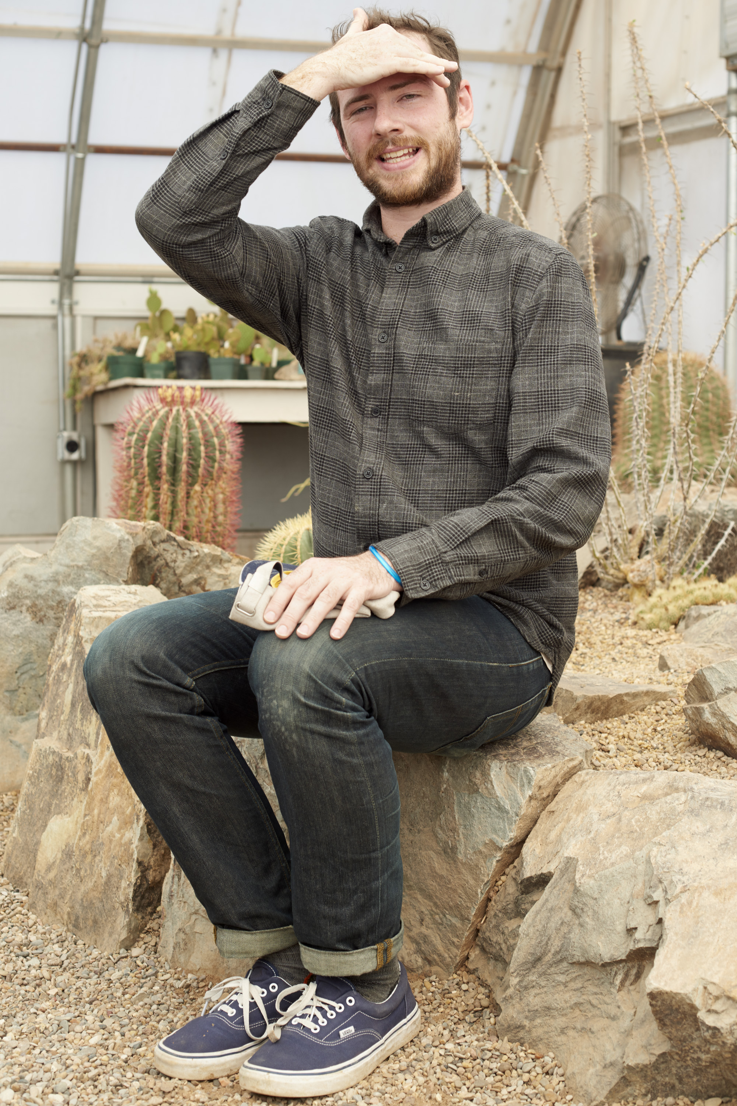
Chris Wright Evans MFA Candidate Photography

Slide 2
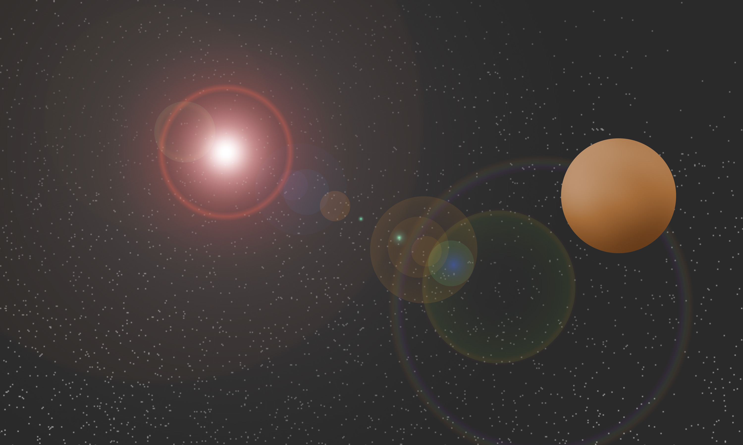
The Dwarf Planet Called Eris Artist Render
Notes:
Eris is roughly the size of pluto, but it is 3 times further from the sun.
A year on Eris, the amount of time it takes the dwarf planet to orbit the sun is 557 years
Light from the sun takes about 15 hours to hit the surface of the planet

Slide 3
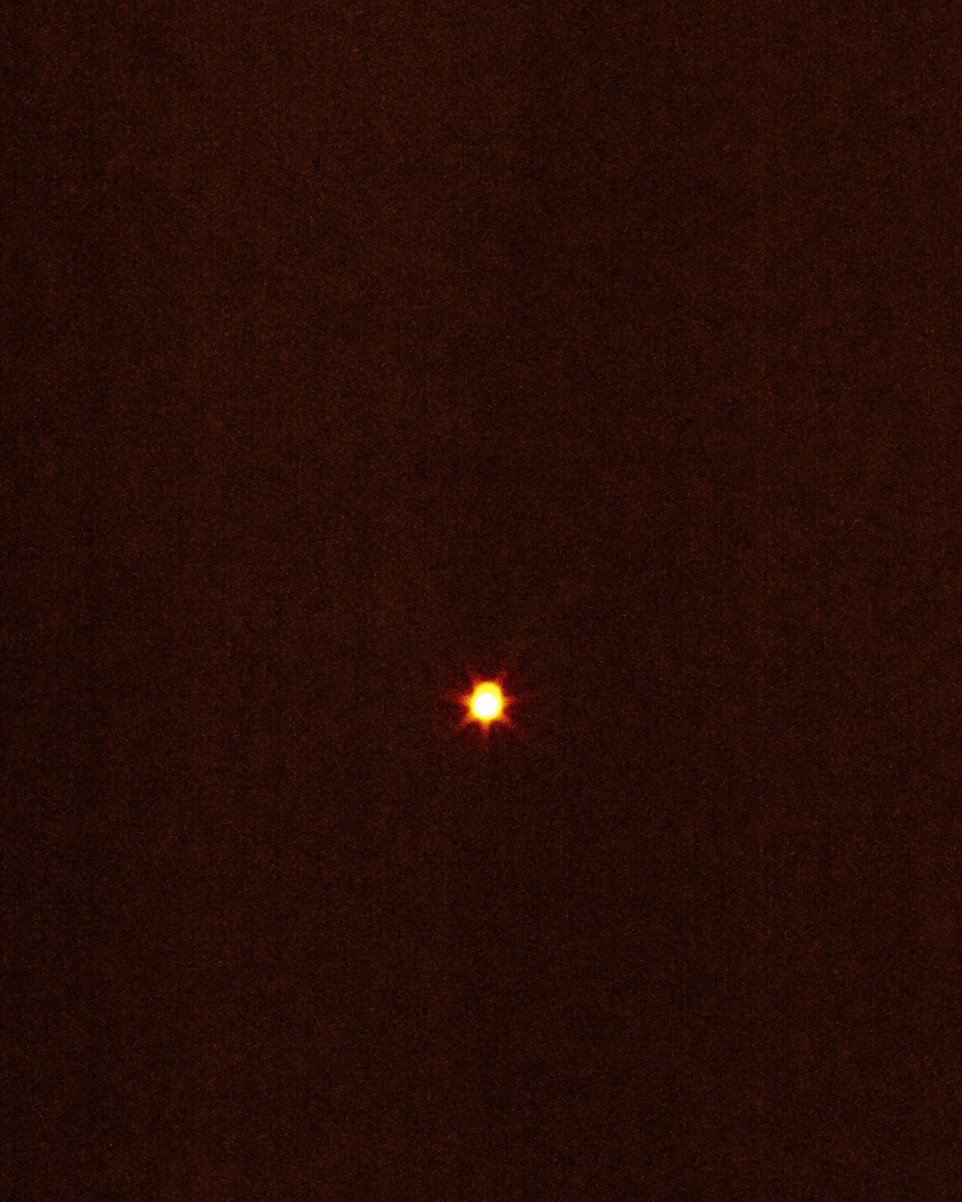
The dwarf planet called Eris pictured from my living room
Notes:
It takes 9.4 hours for sun light to travel across our solar system to hit eris, and another 9 hours for us to see the reflected light

Slide 4
The Evans Family

Slide 5
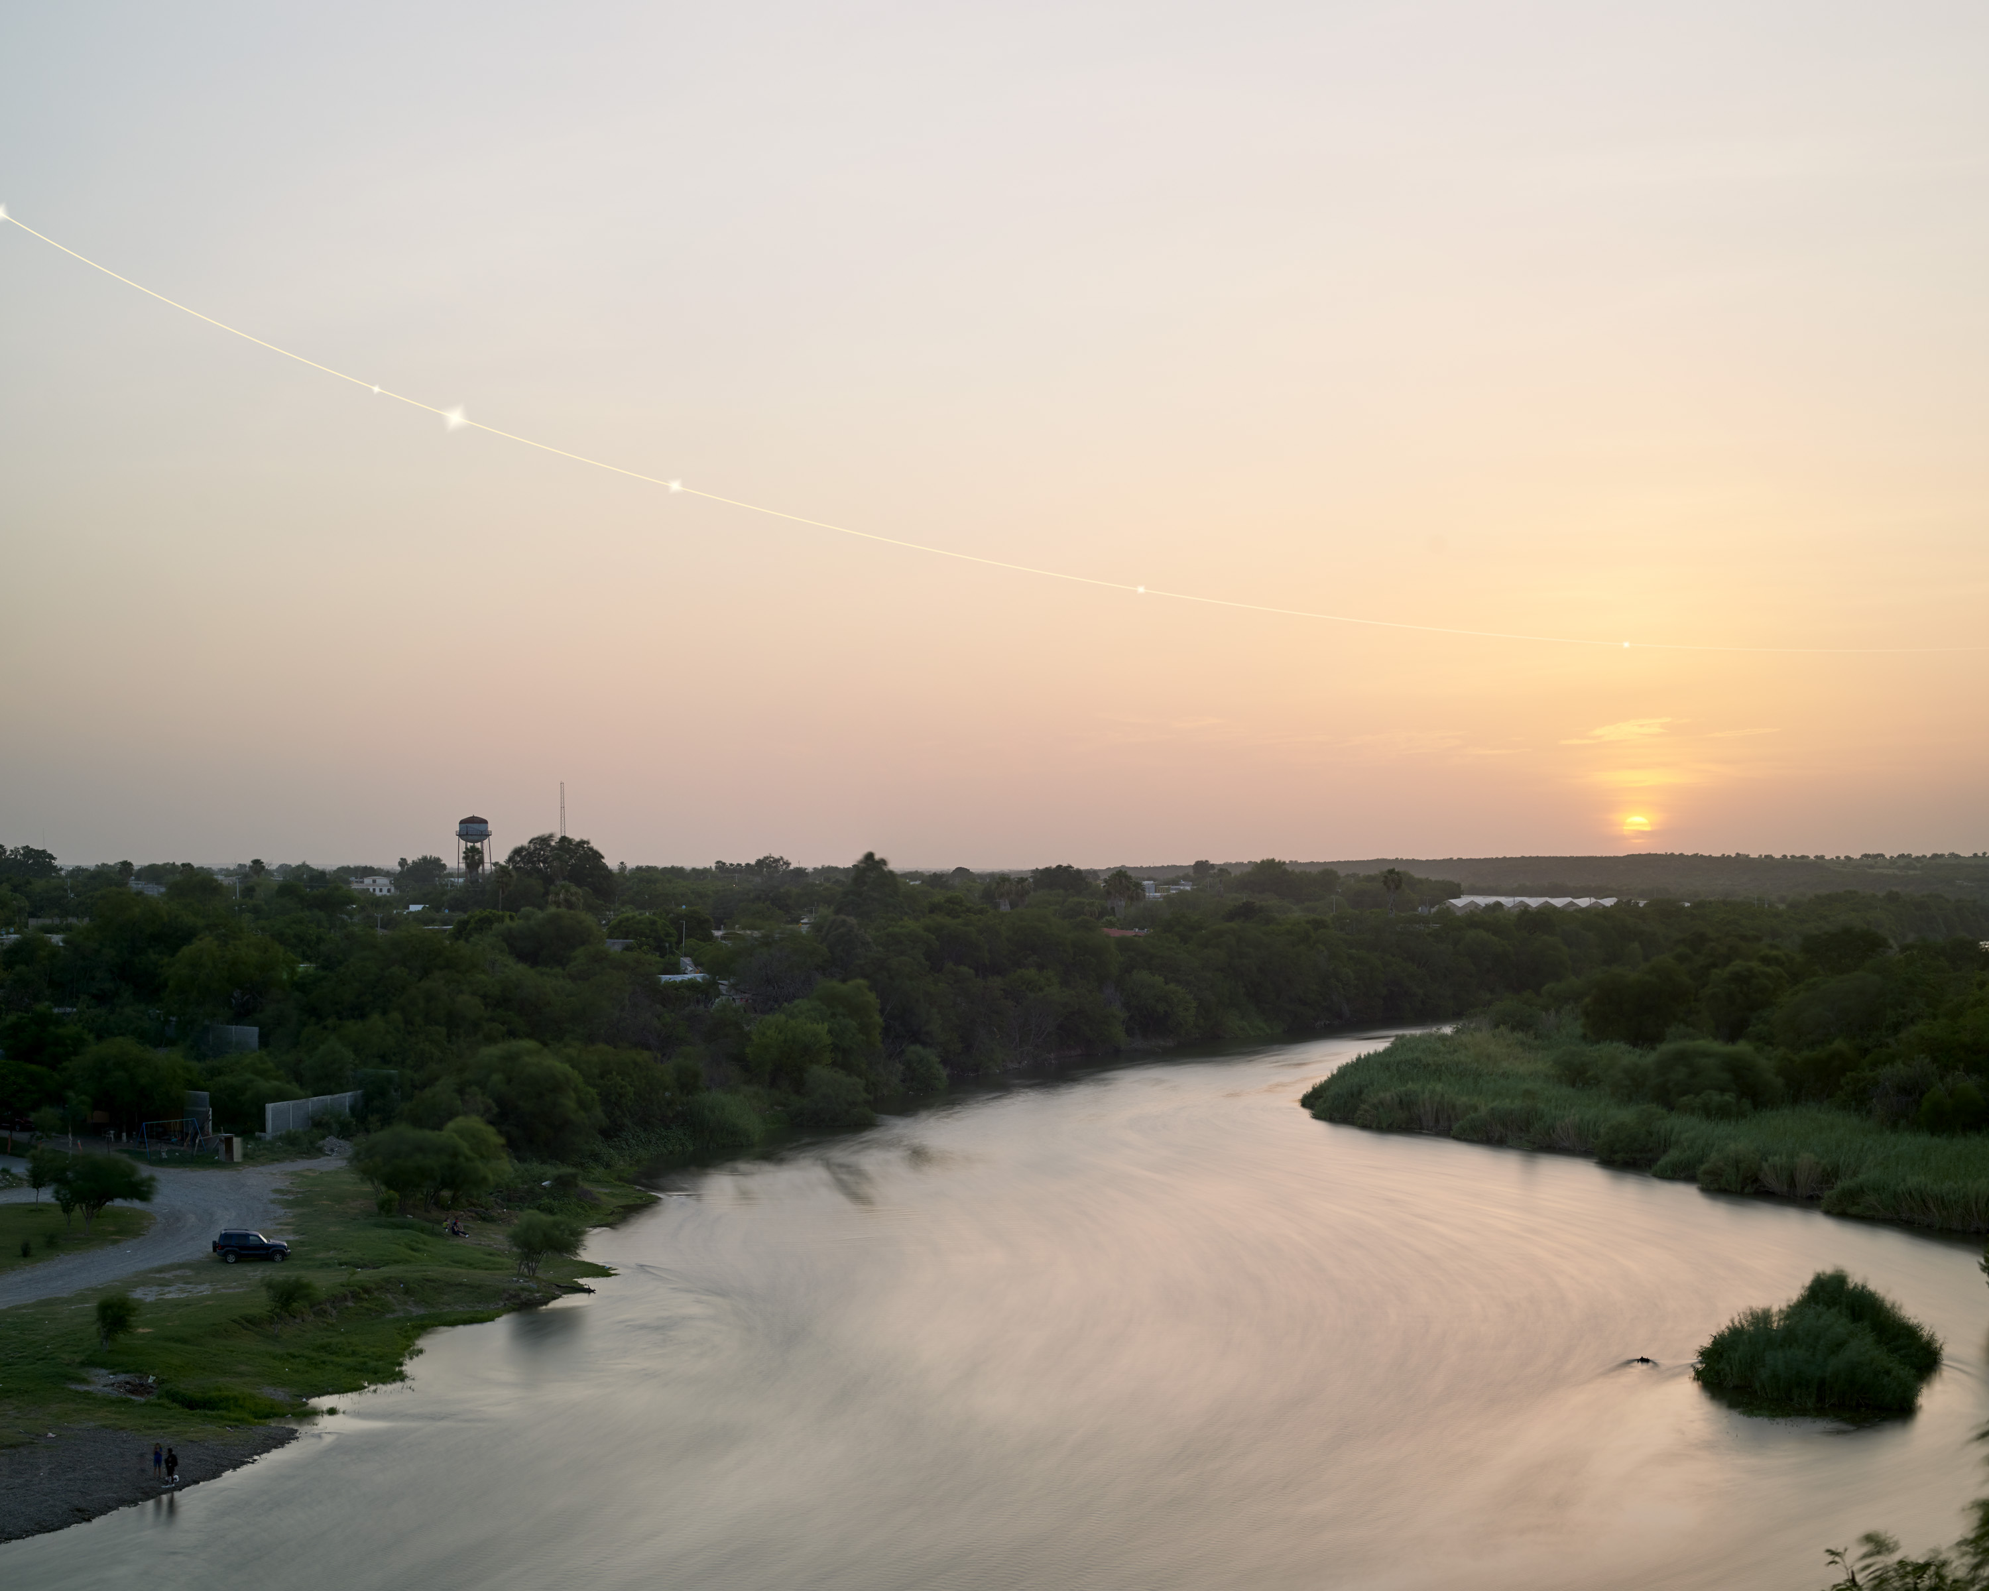
Mothership returning to Eris

Slide 7
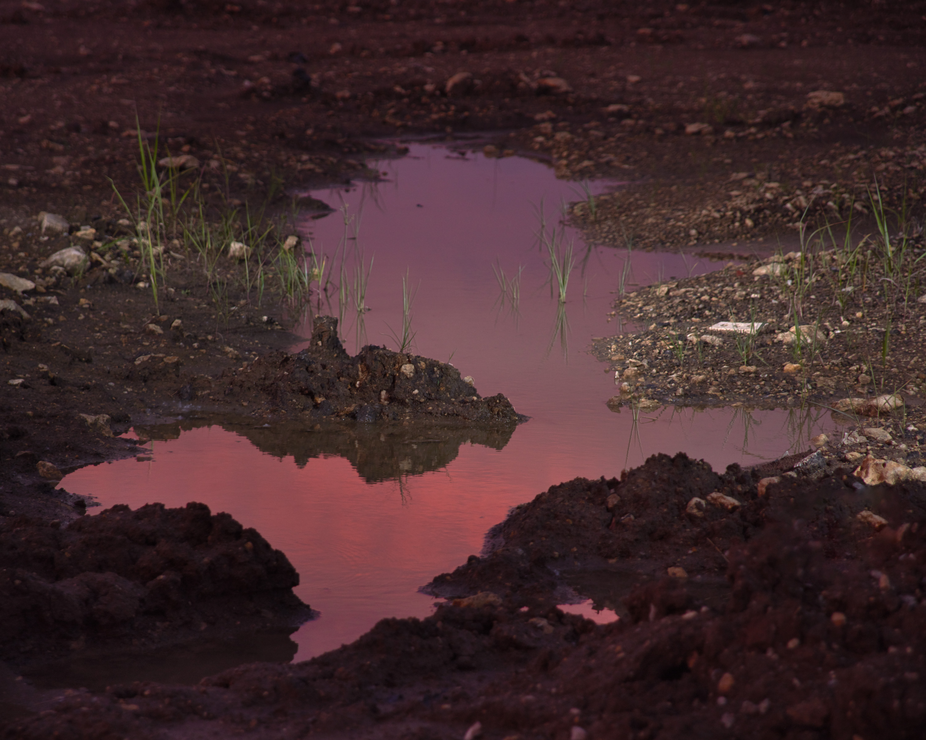

Slide 8
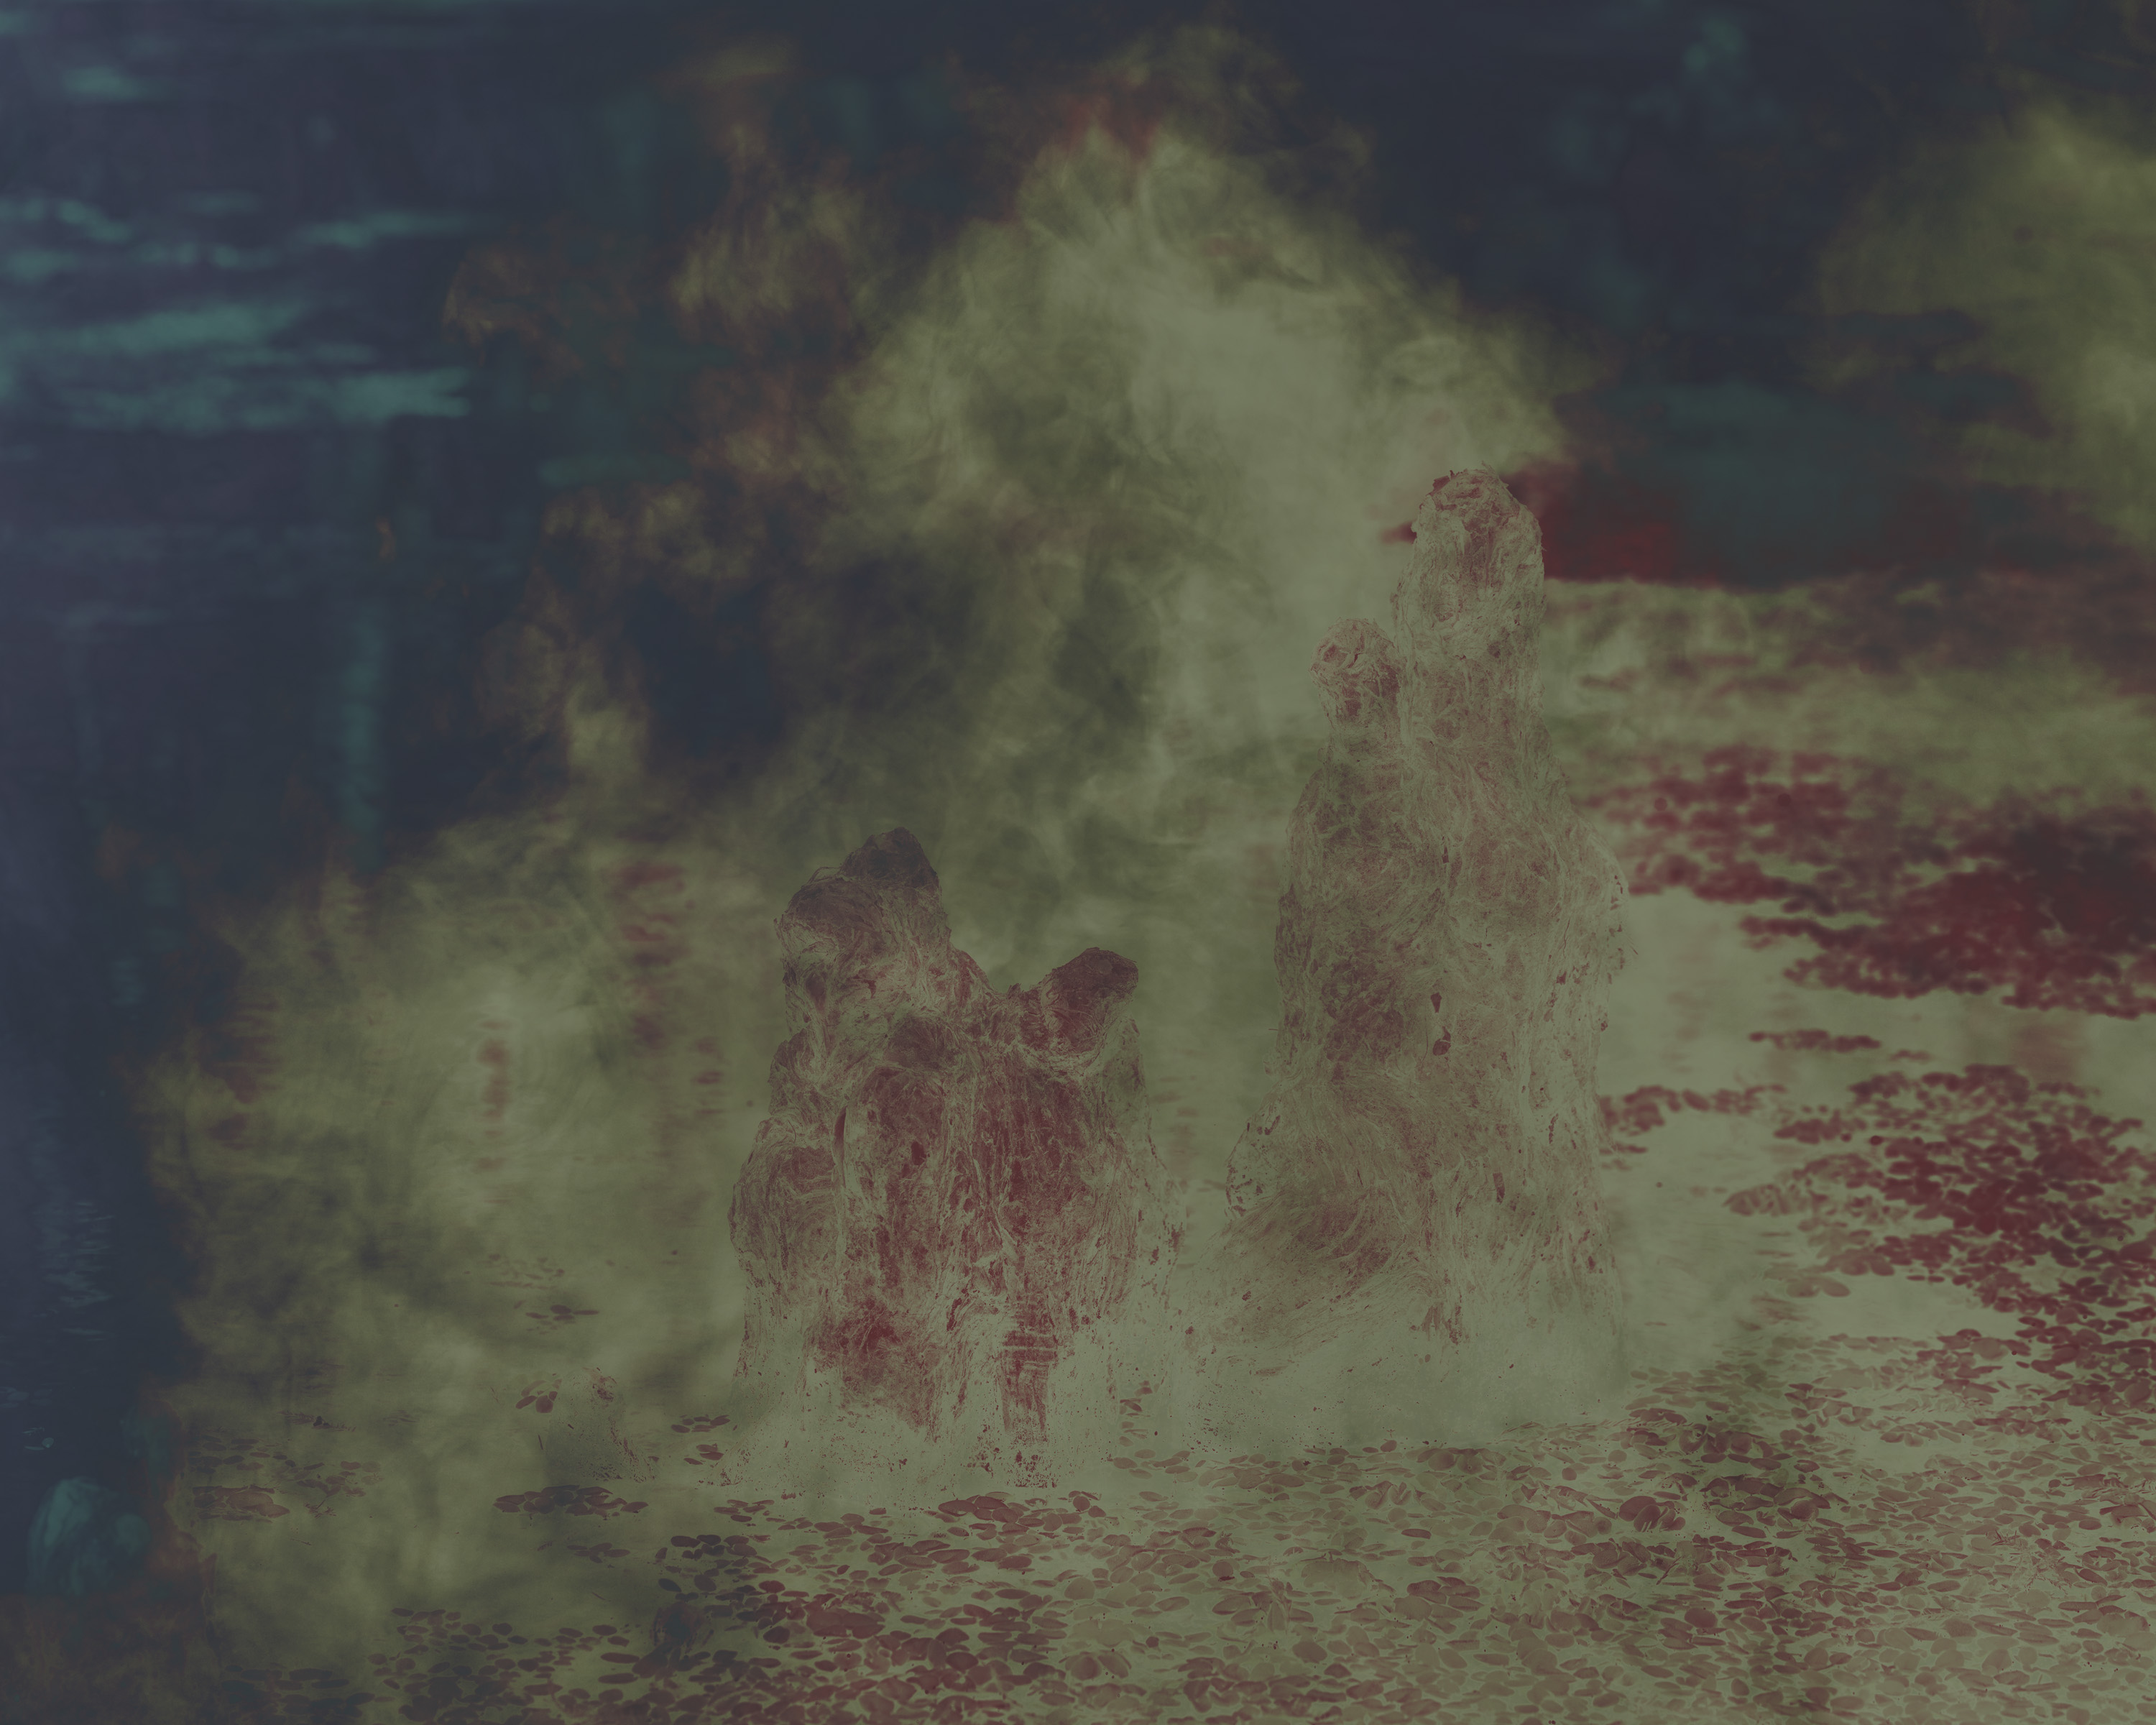

Slide 9
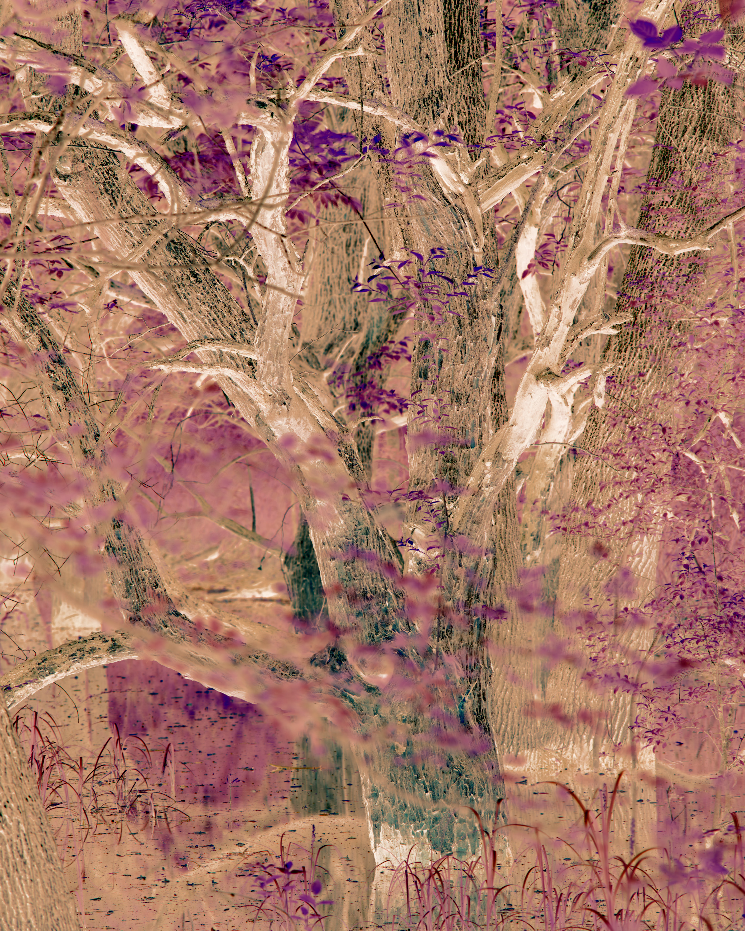

Slide 10
Notes:
The photographic ritual that takes place at tourists sites shows how we use photography and iamges to inform how we interact with the world around us.

Slide 11
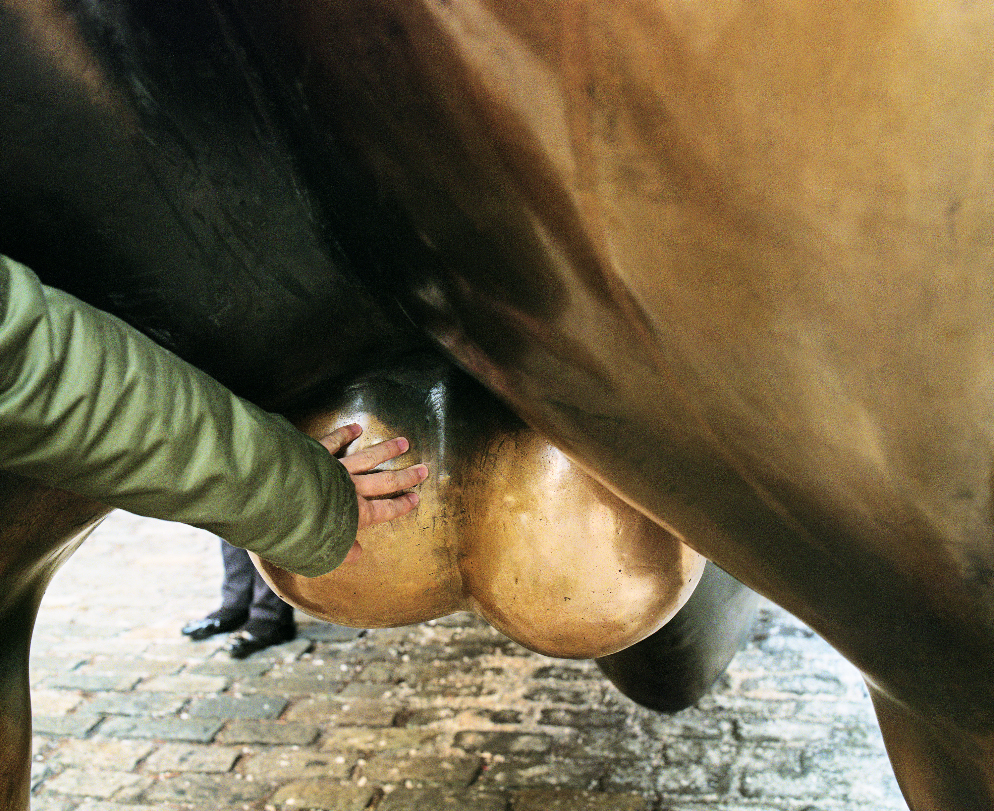
Bull Market, 2014

Slide 12

Photo-op, 2016

Slide 13
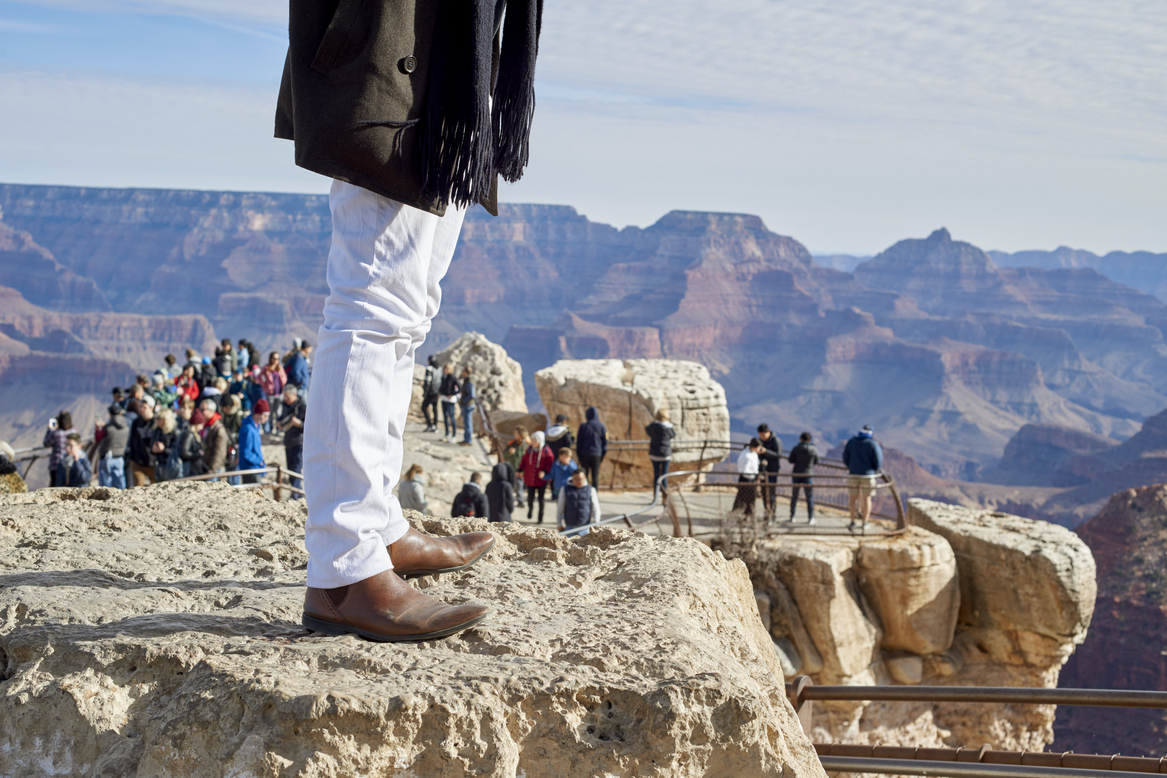
Grand Canyon, 2018

Slide 14

Trifecta, 2019

Slide 15
Notes:
The photographic ritual that takes place at tourists sites shows how we use photography and iamges to inform how we interact with the world around us.

Slide 16

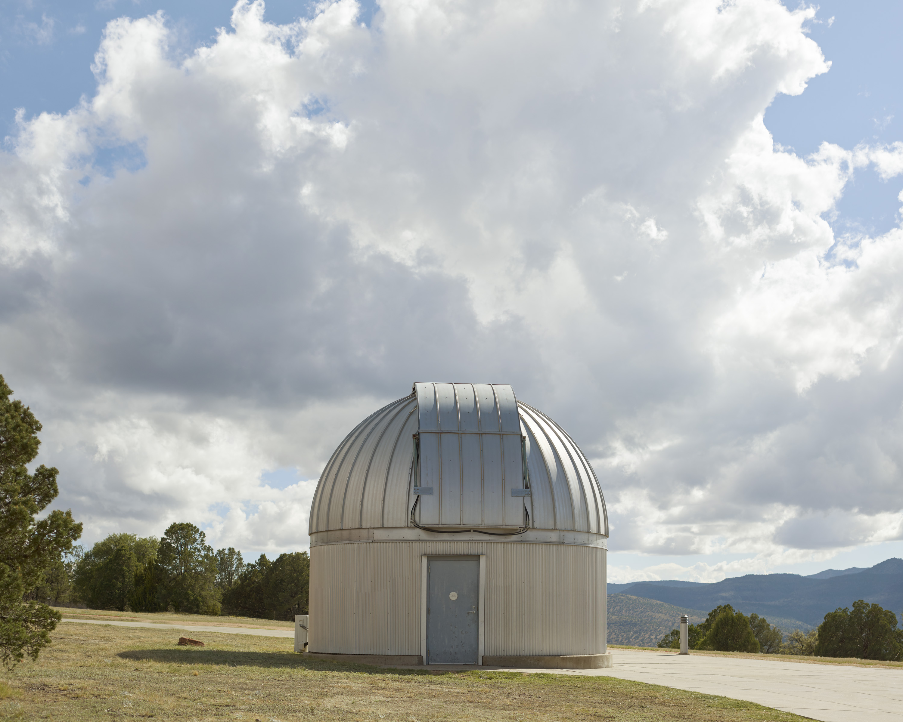
Photograph of Dr. Karl Popper

Slide 17
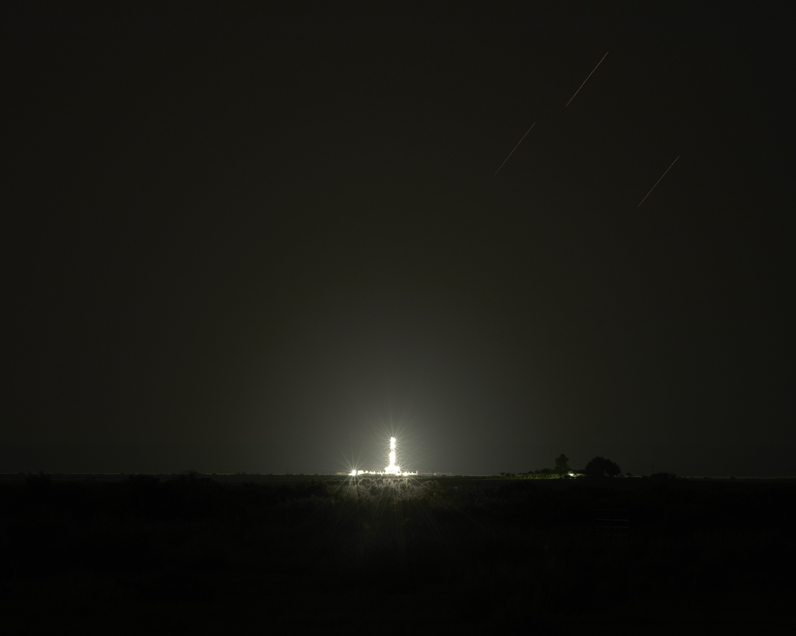
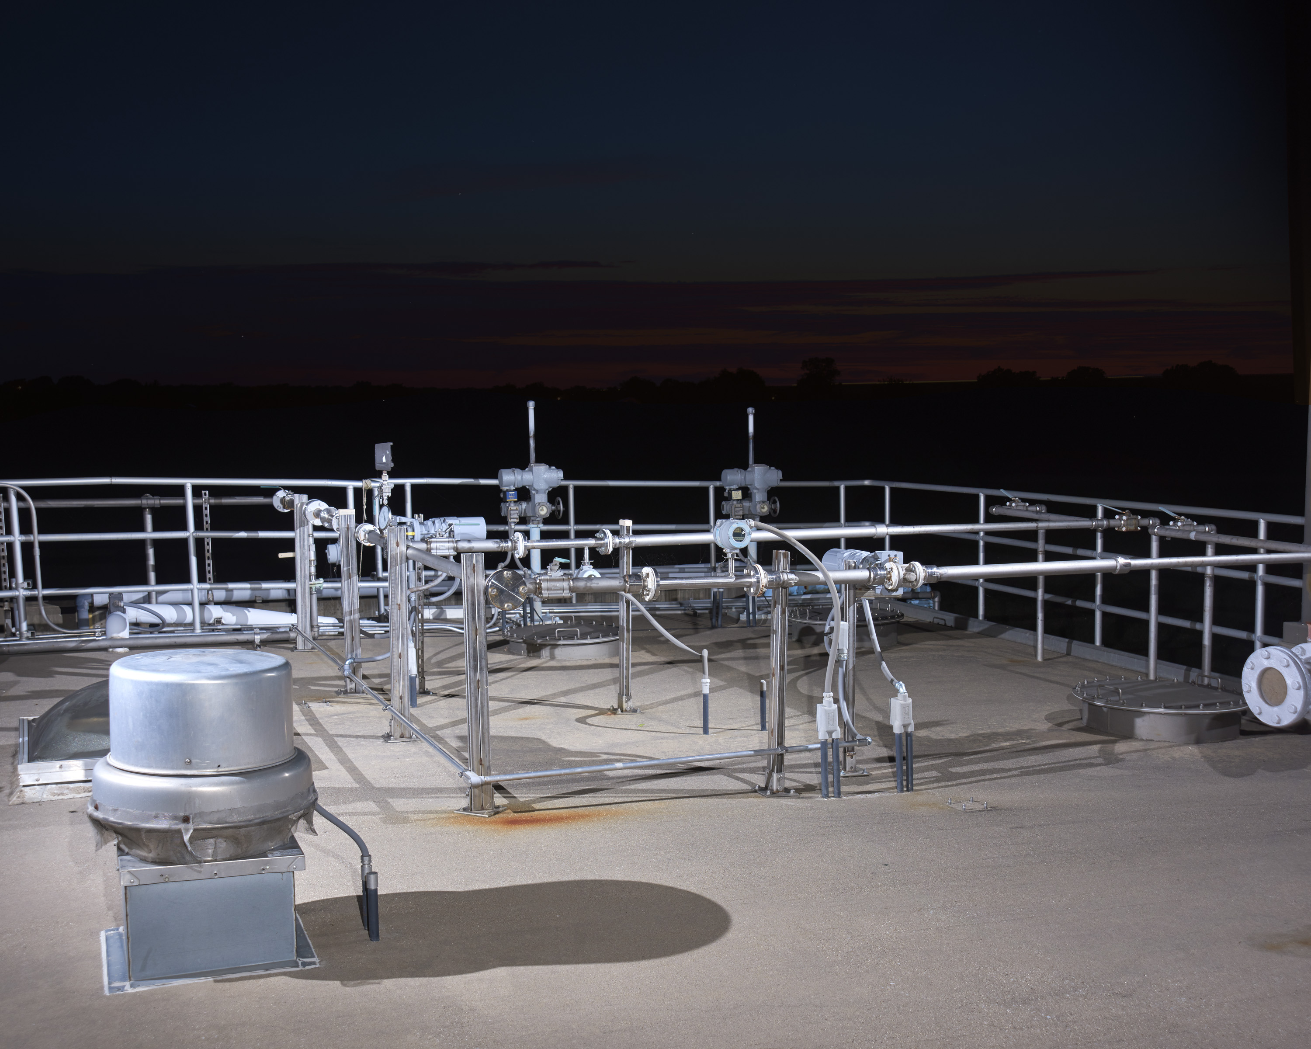
Launch Site, T-minus 10 minutes

Slide 18
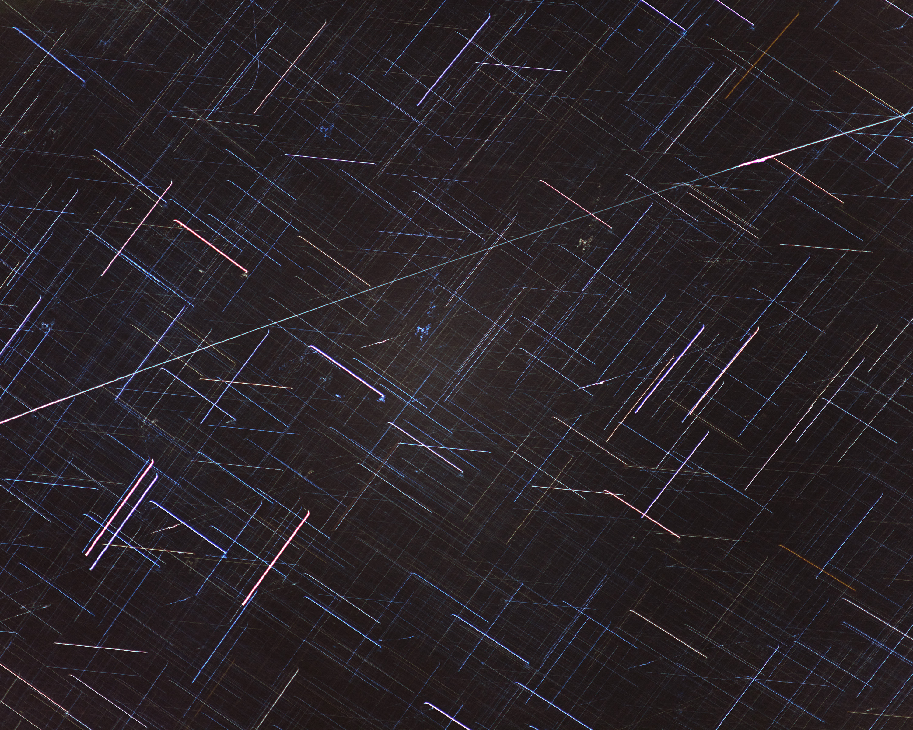
Rocket in slingshot orbit around Earth

Slide 19
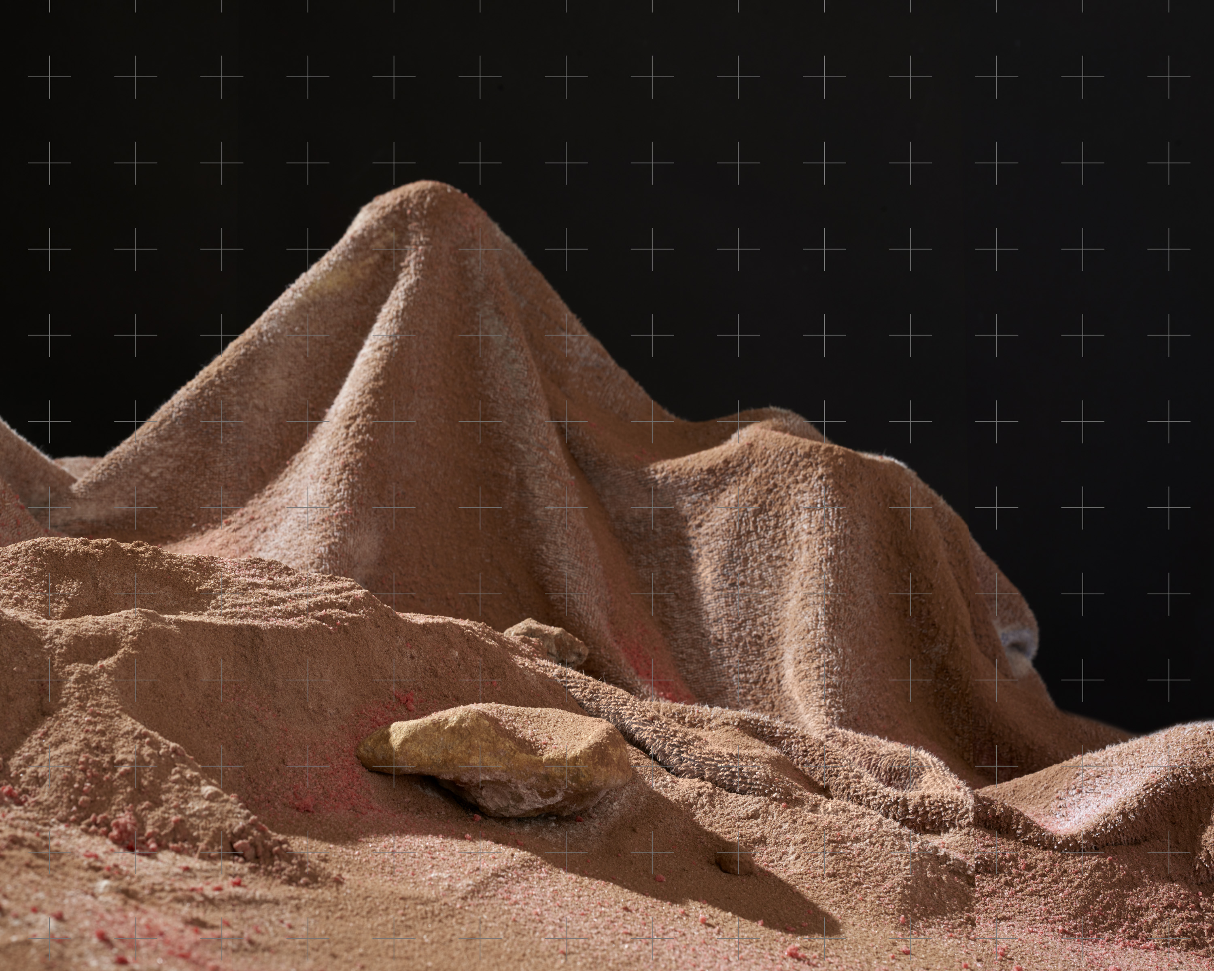
The Dwarf Planet Called Eris Pictured from the Planet Surface

